Slide 1

Data Quality Analysis for Seattle Building Emissions Performance Standard Program
Team: SparkOne
Chenyi(Jenny) Huang
Xin Geng
Miranda Lyu
Muyun Ji

Slide 2
Data Quality Is Crucial for Achieving BEPS Goals
Reduce greenhouse gas emissions
Poor data quality can significantly impact the effectiveness of BEPS policies by hindering accurate measurement and tracking of building energy use and greenhouse gas emissions.
Build healthy communities
High-quality data serve as the foundation for understanding the complexities of energy use and emissions within diverse communities and for designing interventions that are both effective and equitable.

Slide 3
Approach
Through reading documents and interviewing with the relevant staff, we understand where the data is from and who handles the data input, and conclude that potential problems might arise from various manual inputs.
Statistically, we analyze the 2022 and 2021 Building Energy Benchmarking Data to assess the following aspects regarding the data quality:
Data Timeliness
Data Completeness
Data Accuracy
Data Consistency
Tools: Python/VSCode

Slide 4


Our Conclusion on Data Quality
Data Completeness
Data Timeliness
Data Accuracy
Data Consistency

Slide 5
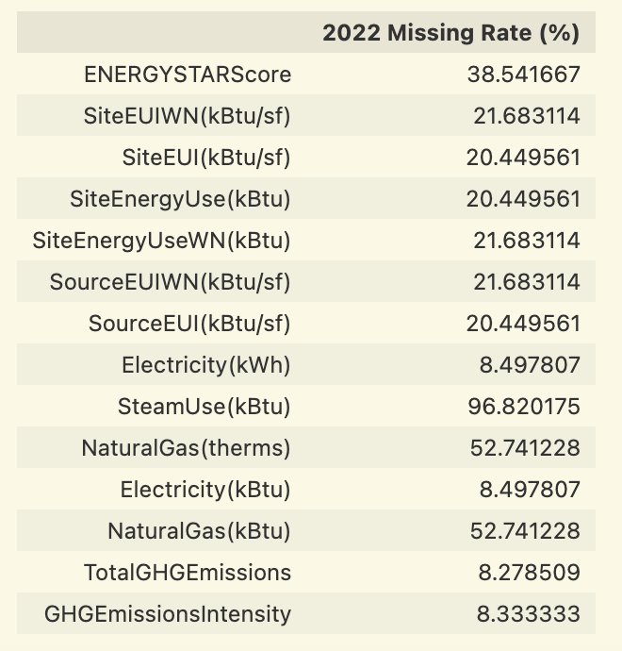
Data Timeliness - (2022)
Lagging in Data Collection
2022 data is still in progress and have many missing values.
(represented by blanks in the dataset)

Slide 6
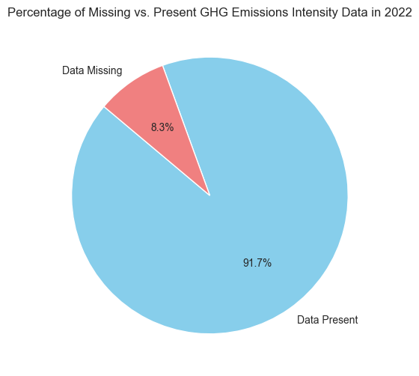
Data Completeness - Missing GHG Emission Data
In the 2022 dataset, 8.3% of the entries lack data on greenhouse gas emissions.

Slide 7
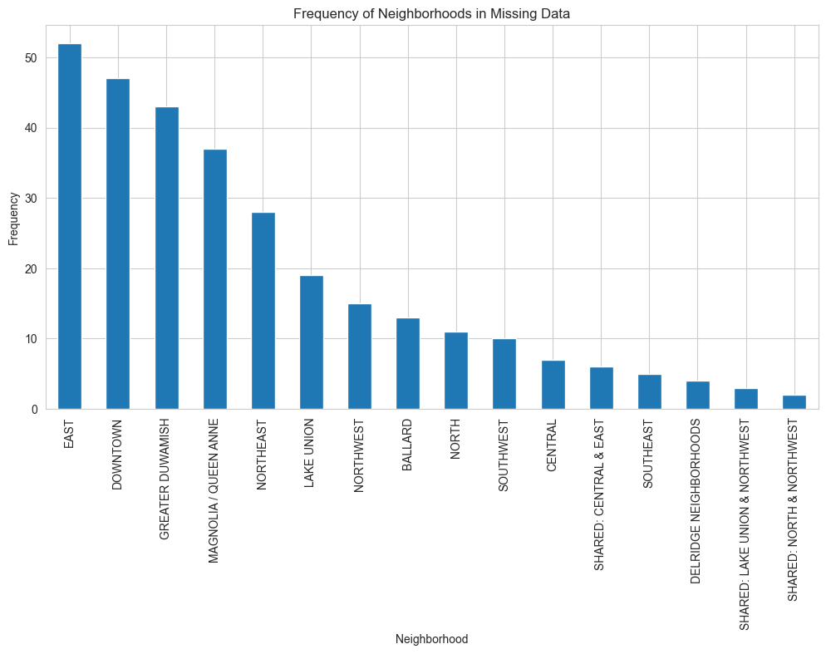
Data Completeness - Missing Data by Neighborhood
Top 3 Neighborhoods
East (Highest/Second Highest/Middle Equity Priority) = 17%
Downtown (Highest Equity Priority) = 16%
Greater Duwamish (Highest/Second Highest Equity Priority) = 14%

Slide 8
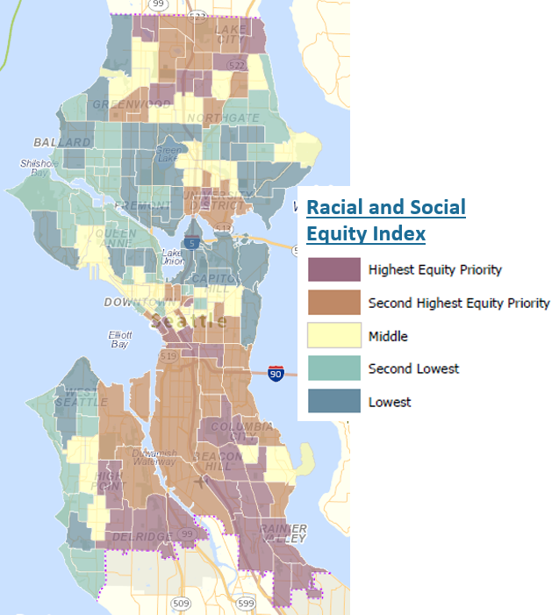
Data Completeness - Missing Data by Neighborhood
These areas happen to be with higher Equity Index

Slide 9
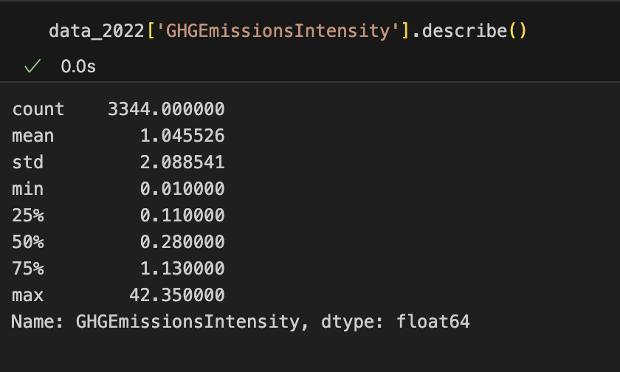
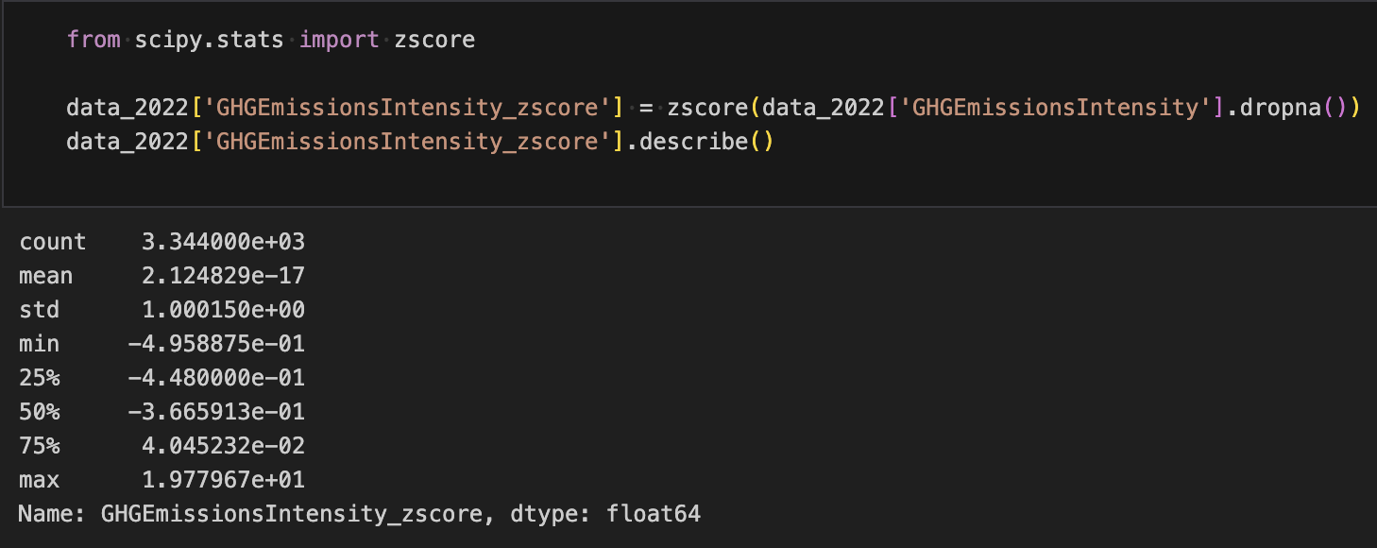
Data Accuracy - Questionable GHG Emission Intensity
Large Standard Deviation
Wide Data Range (max-min)
High Z-Score

Slide 10
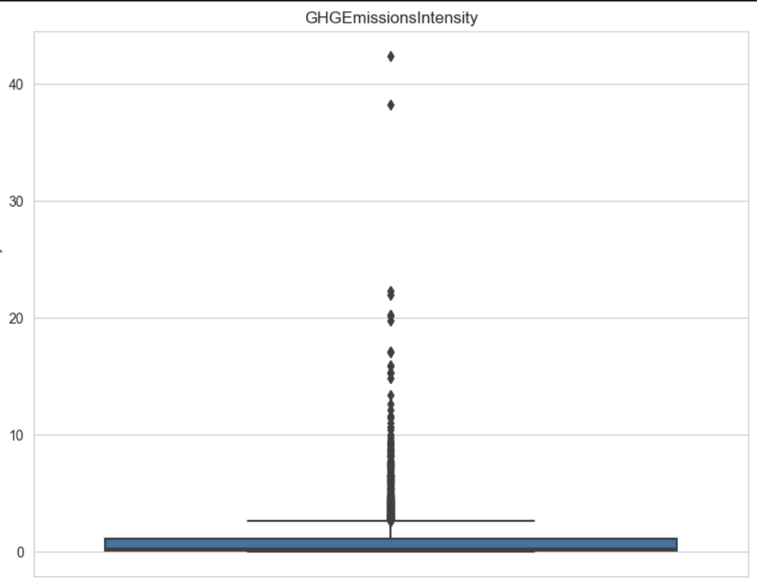
Data Accuracy - Questionable GHG Emission Intensity
The maximum GHG Emission Intensity is about 40 times higher than the lowest.

Slide 11
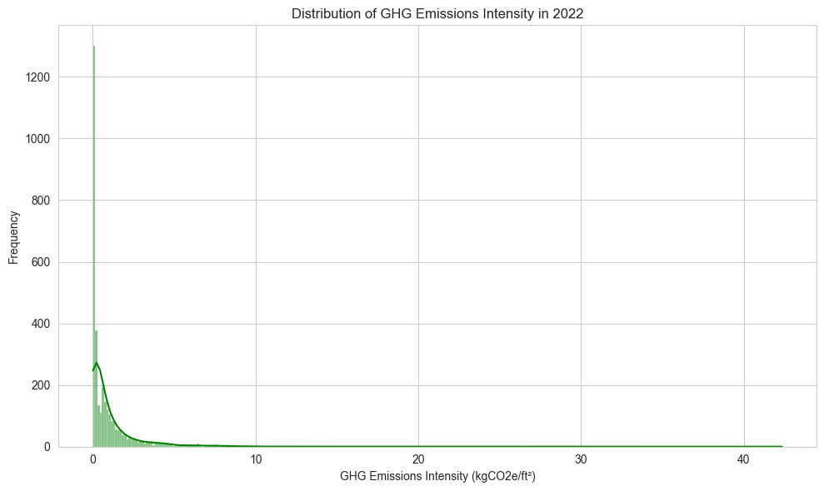
Data Accuracy - Questionable GHG Emission Intensity
Right-skewed distribution flags a few potential outliers that represent unusually high GHG Emission Intensity data (on the right)

Slide 12
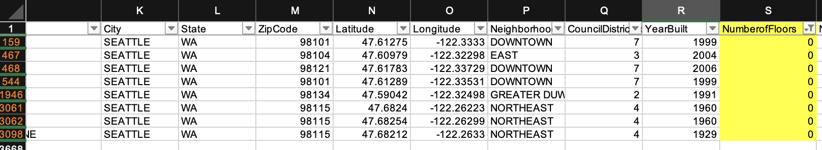
Data Accuracy - Invalid Data Points
Number of Floors = 0 in 2022 dataset ?

Slide 13
Data Consistency - 2 year comparison (2022 vs 2021)
Same property name, different OSEBuildingID
Same property address, different property name and OSEBuildingID
Property present in one year but absent in the other year

Slide 14
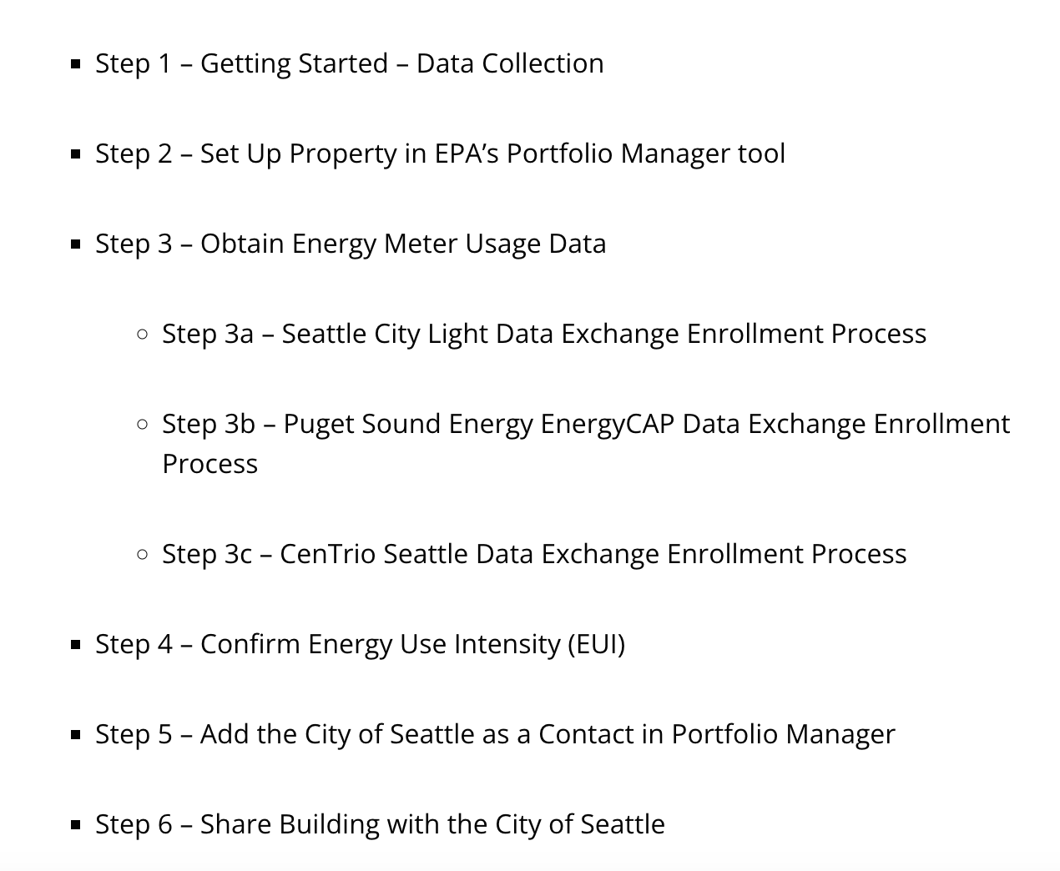
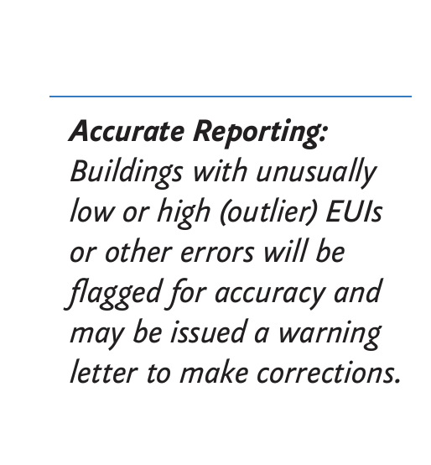
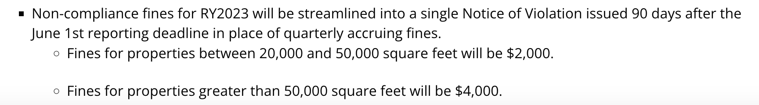
Current Data Collection Process
Some data automation and data validation methods have been placed

Slide 15
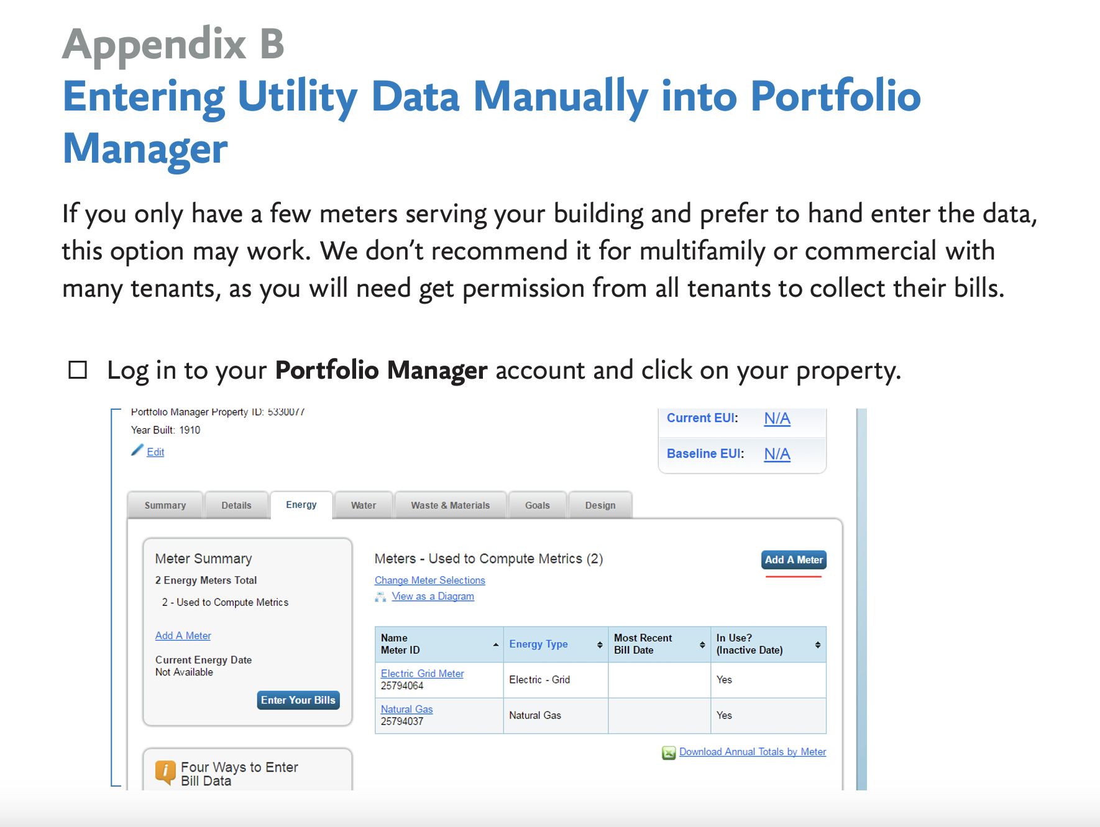
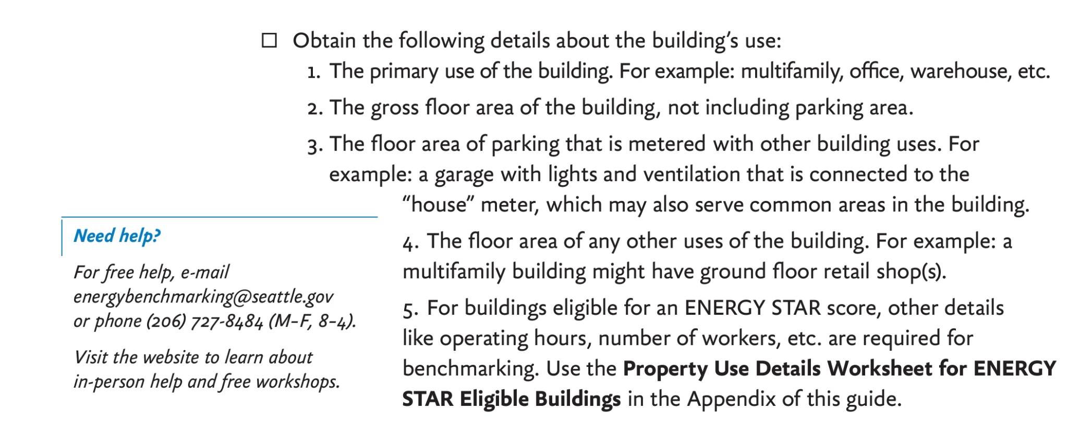
Current Data Collection Process
Manual input is still allowed for utility data and building information

Slide 16
Tools/Methods to Improve Data Quality
Cleaning the database comprehensively
Ensure the unique OSEBuildingID is consistent across different time periods or years
Identify existing outliers/errors
Accuracy
Consistency

Slide 17
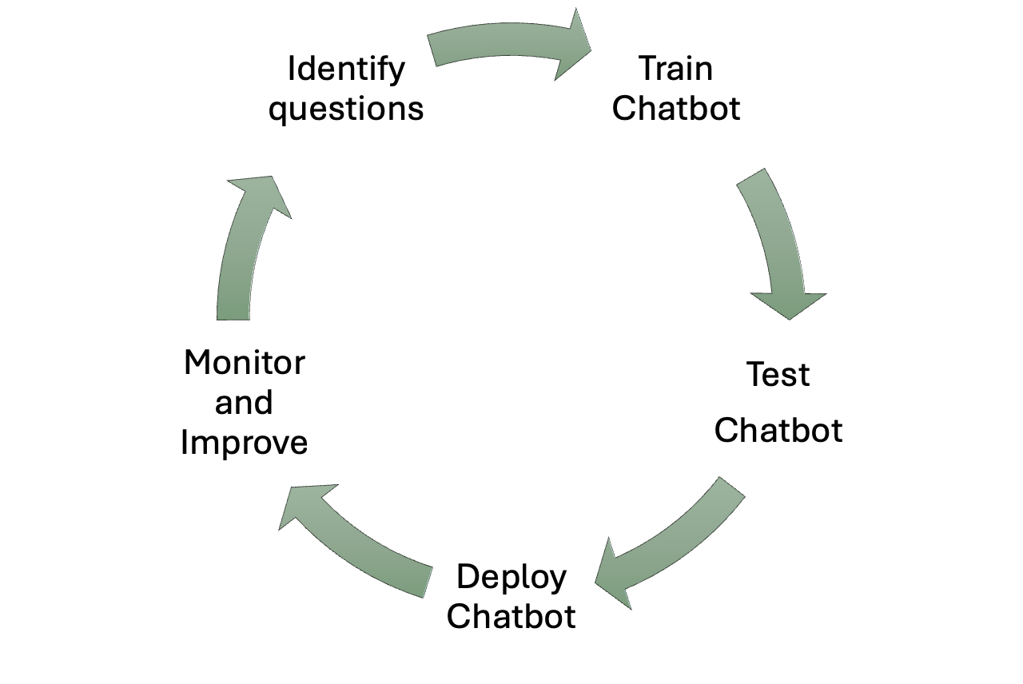
Tools/Methods to Improve Data Quality
AI Chatbot
Completeness
Accuracy
Timeliness
Assist portfolio managers during data entry process
More accurate results with better
Understanding of the definitions of specific data terms
Access to helpful instruction/training resources
Smoother set up process with the utility data exchange enrollment
Direct utility data reading

Slide 18
Tools/Methods to Improve Data Quality
Volunteer outreach in neighborhoods
Promoting Seattle’s Building Energy Benchmarking Program
Educate Portfolio Managers on data
Provide guidance to Portfolio Managers in data collecting and entry
Collect feedback from Portfolio Managers regarding the process
Follow-up visits if needed
Completeness
Accuracy

Slide 19
Tools/Methods to Improve Data Quality
Data Dashboard with AI
Assist City of Seattle to monitor data collection process
Easier data monitor process by data visualization
Display key data quality metrics
Red flag obvious errors and missing data fields
Show data completeness of all or single building(s)
Faster response with missing or inaccurate data
Completeness
Accuracy
Timeliness

Slide 20
Limitations and Future Considerations
Our current observations might be biased
Further analysis on data accuracy is required
Use machine learning algorithms to identify outliers, detect anomalies, and estimate missing values to evaluate data accuracy in the datasets
Talk with experts to gain industry knowledge and understand data patterns
Dive deeper into the existing data collection process
Engage with more relevant staff to gain insights into the challenges they face
Go through the Energy Star Portfolio Manager System in person

Slide 21
References
City of Seattle's Open Data portal: https://www.seattle.gov/environment/climate-change/buildings-and-energy/energy-benchmarking/data-and-reports#individualbuildingdata
How to Benchmark Guide: https://seattle.gov/documents/Departments/OSE/Benchmark/2022-%20How-to-Guide%20NO%20PSE%20combined.pdf
Racial and Social Equity Index: https://experience.arcgis.com/experience/494bdbb2da4f4574bb330f072bc77073

